Slide 1


Slide 2
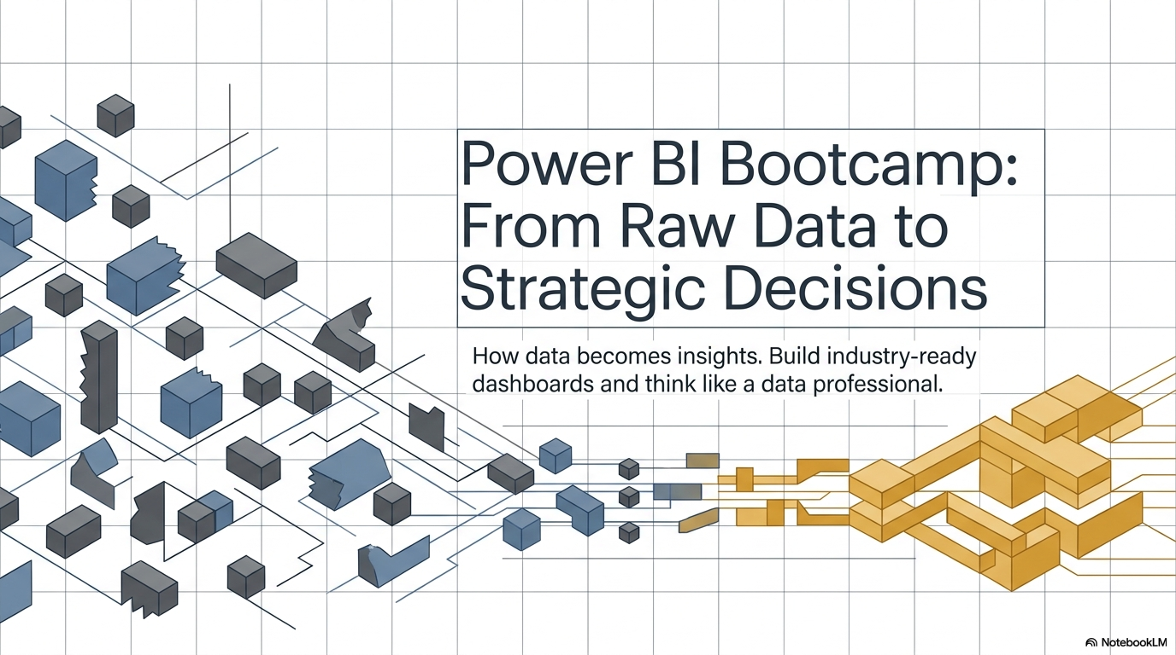

Slide 3





Amit Chandak
Learn Power BI
Data Platform-MVP
Power BI community Super User
YouTuber
BIWorld.in
CAO- Kanerika
https://www.linkedin.com/in/amitchandak78/

Slide 4



Slide 5
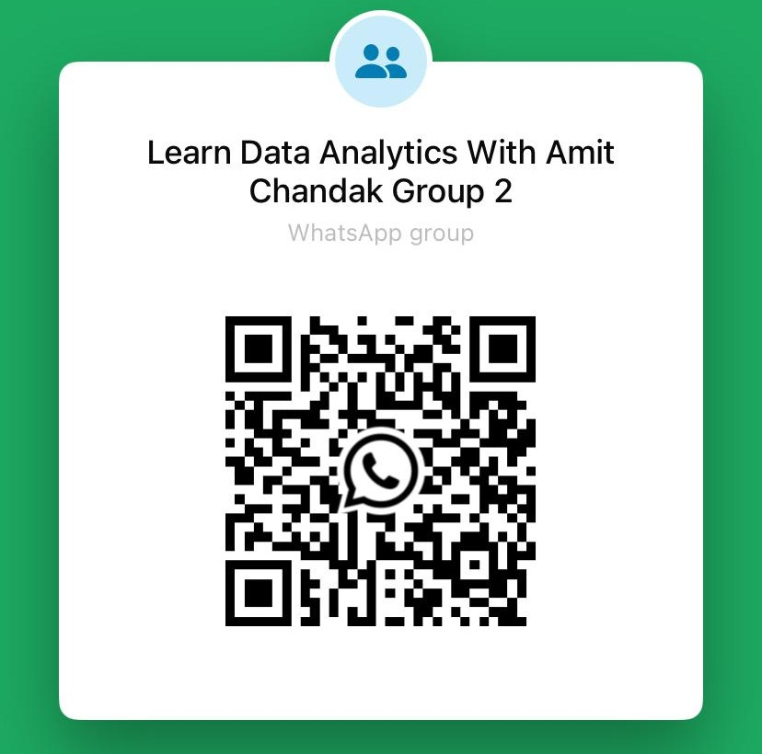

Join Us
India Fabric Group

Slide 6
What You need to Know
Data
How Data is Stored
Basic of Databases and SQL
Basic of Datawarehouse
Fact/ Transactions
Dimension /Master/Common
OLTP
OLAP
STAR Schema
Snowflake Schema
Basic Excel
Business Intelligence

Slide 7

What is Data
Wikipedia “Data is a set of values of qualitative or quantitative variables. Data and information are often used interchangeably”
Data is collected to provide information. Data can be structure, unstructured or semi structured. We are generating data every moment, any action we do may be creating data

Slide 8
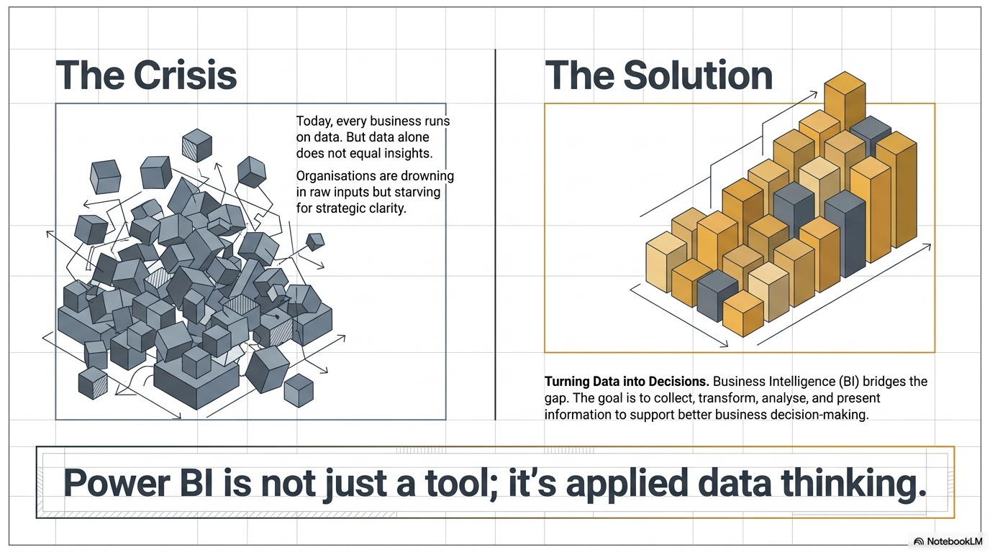

Slide 9
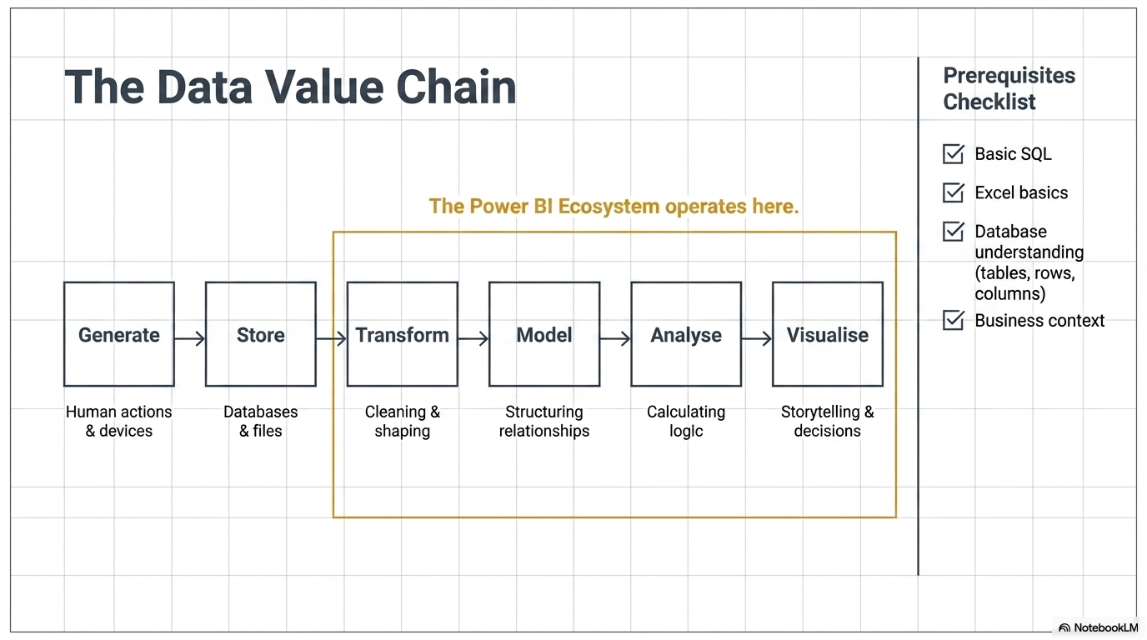

Slide 10
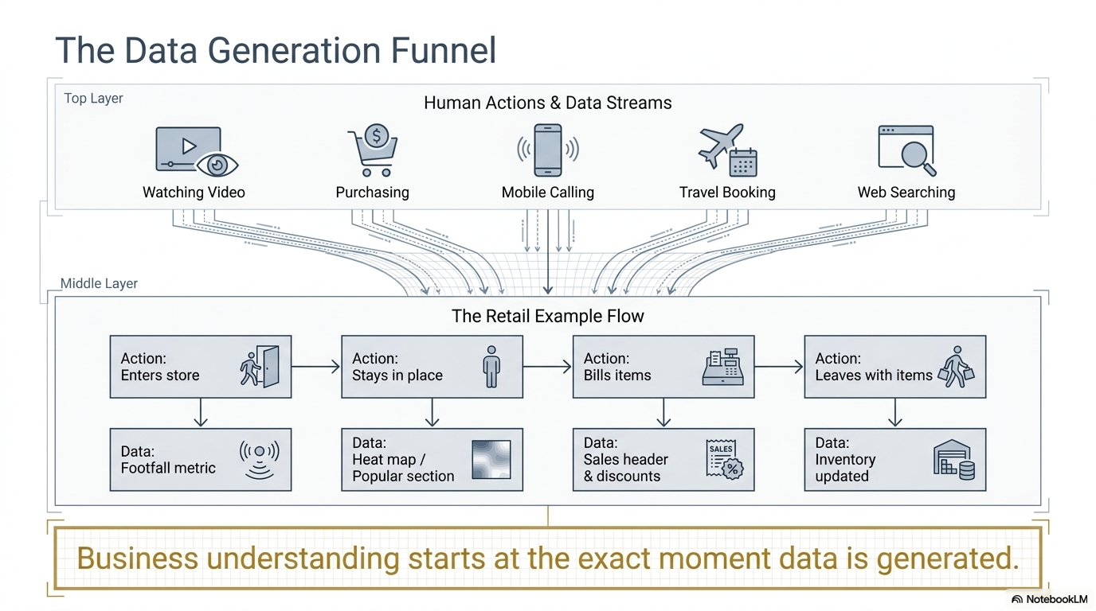

Slide 11
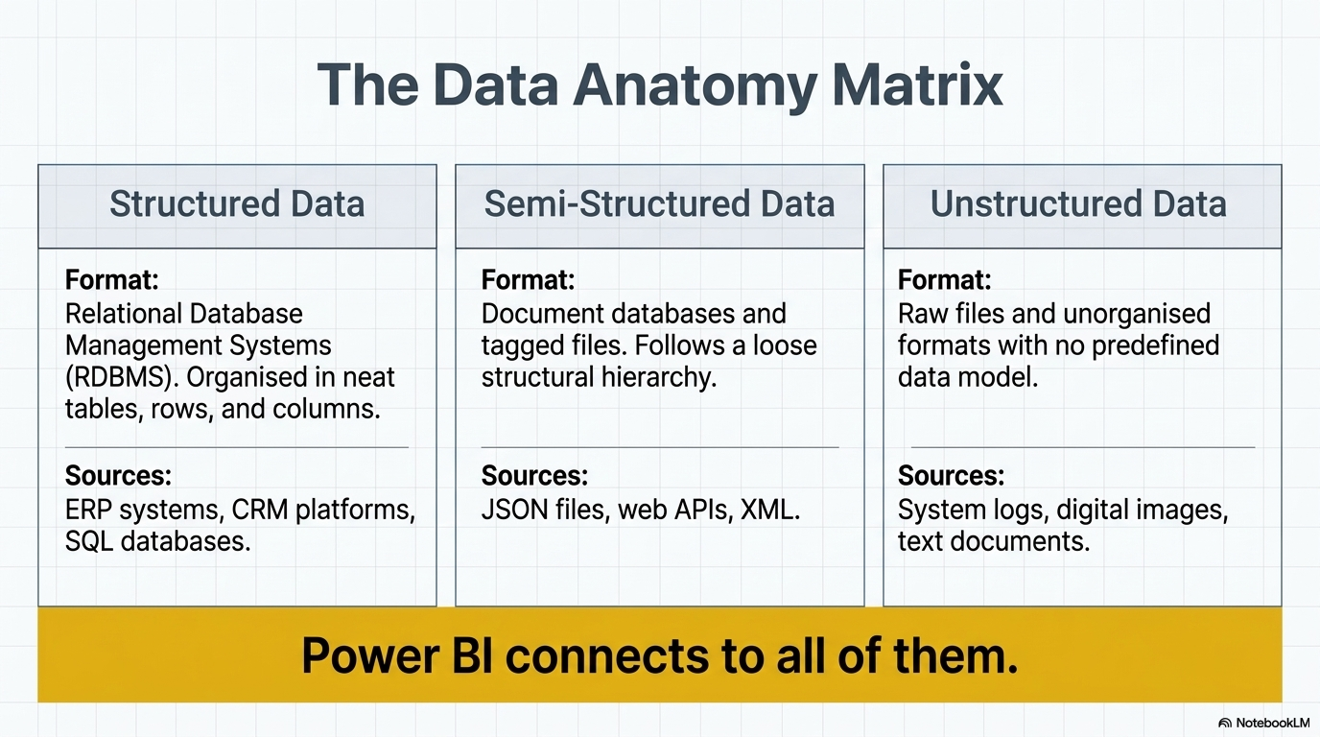

Slide 12
What Is Business Intelligence
Business intelligence is related to decision making
olap.com “The term Business Intelligence (BI) refers to technologies, applications and practices for the collection, integration, analysis, and presentation of business information. The purpose of Business Intelligence is to support better business decision making.”

Slide 13
What is Power BI
Power BI is Microsoft's business analytics platform that helps you turn data into actionable insights. Whether you're a business user, report creator, or developer, Power BI offers integrated tools and services to connect, visualize, and share data across your organization.

Slide 14
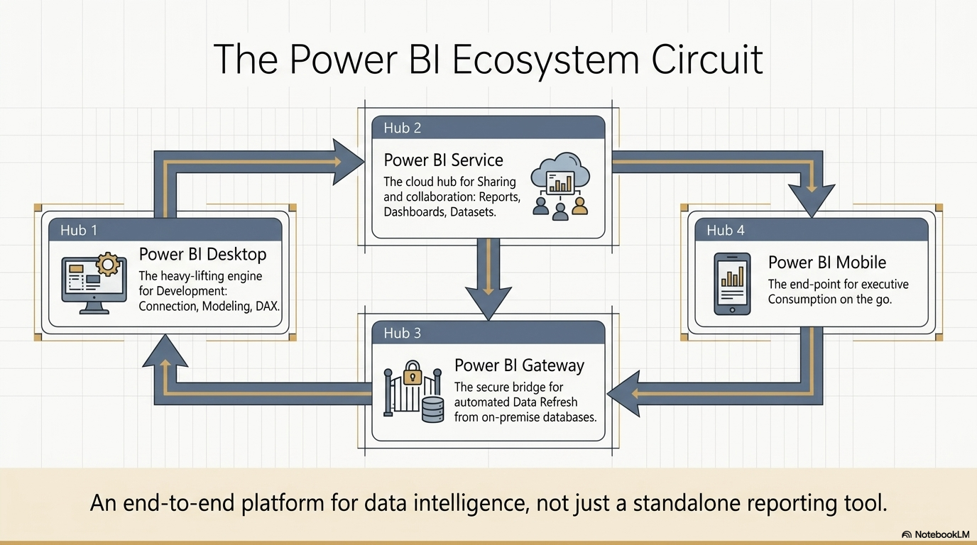

Slide 15
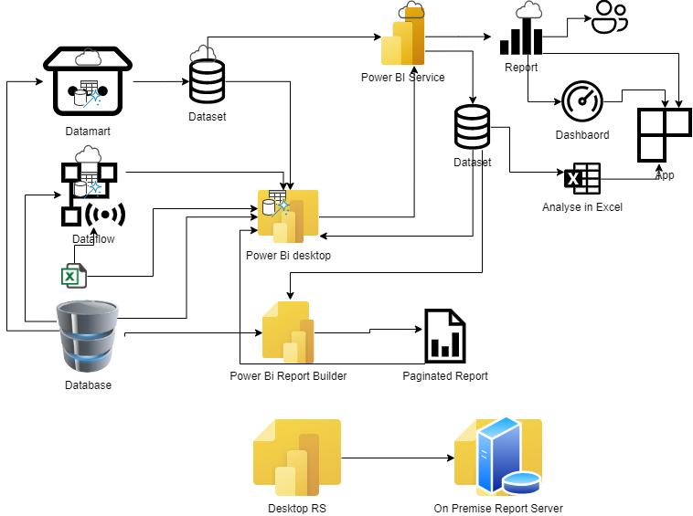
Power BI Ecosystem

Slide 16
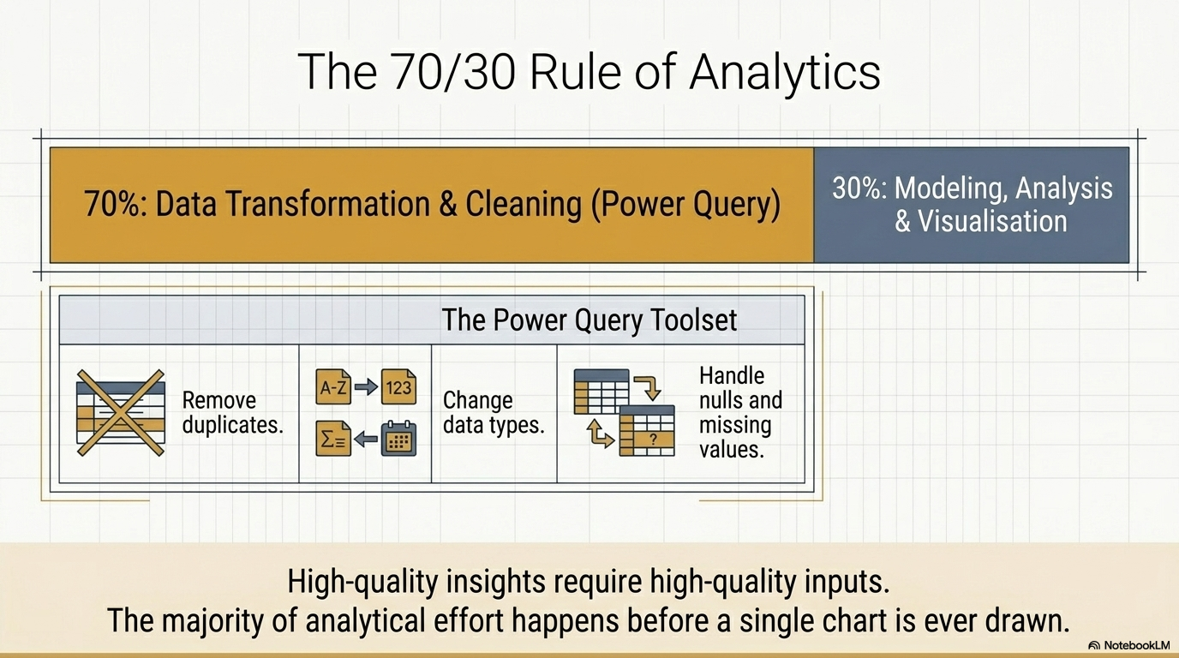

Slide 17
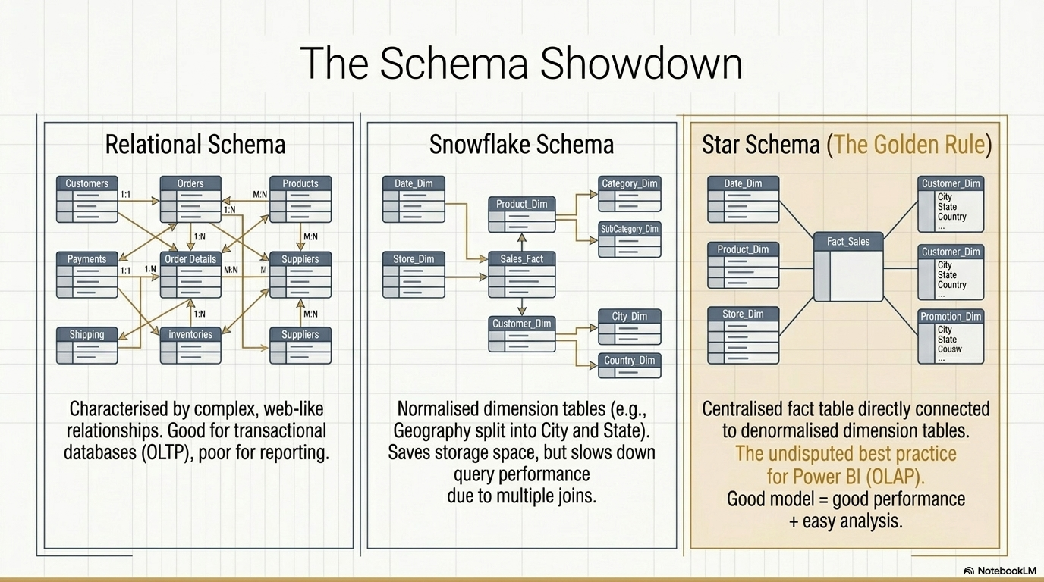

Slide 18

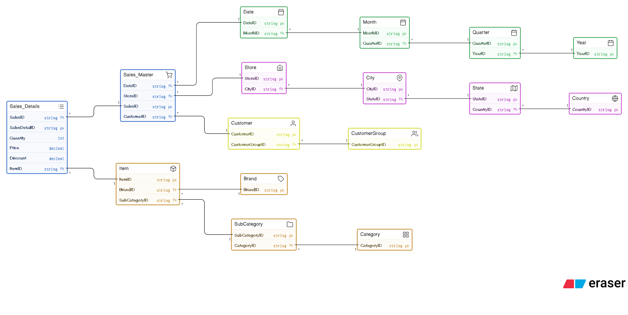

Slide 19
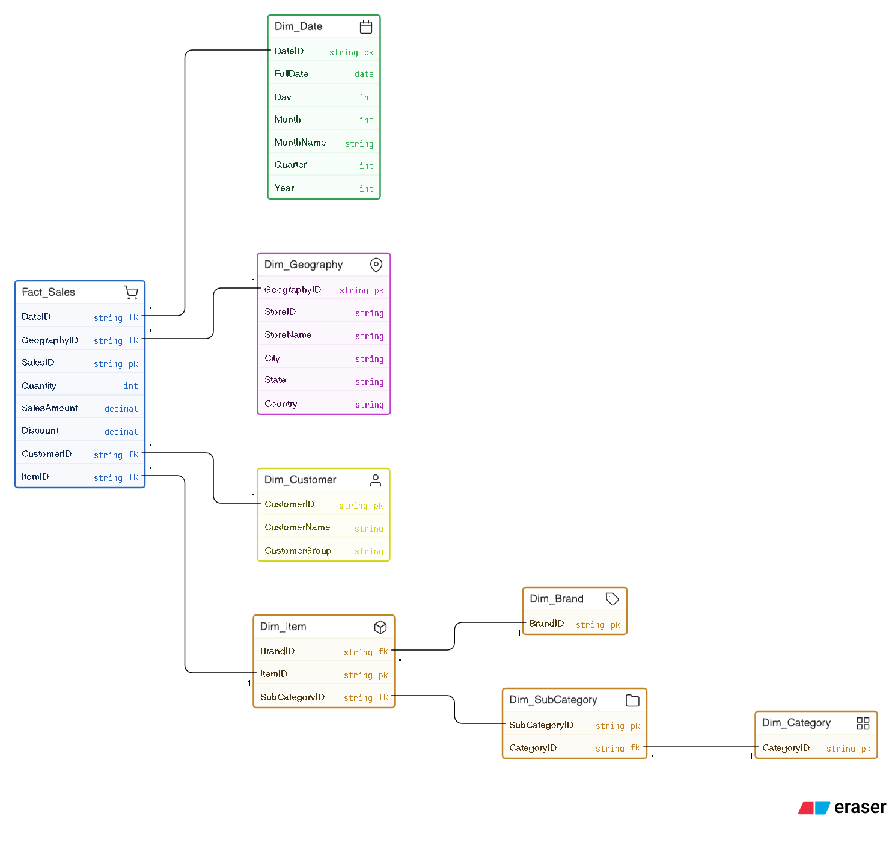


Slide 20

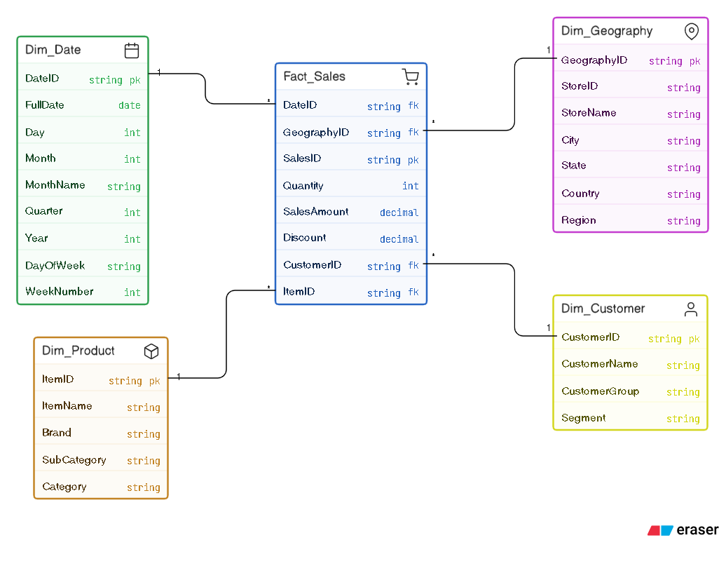

Slide 21
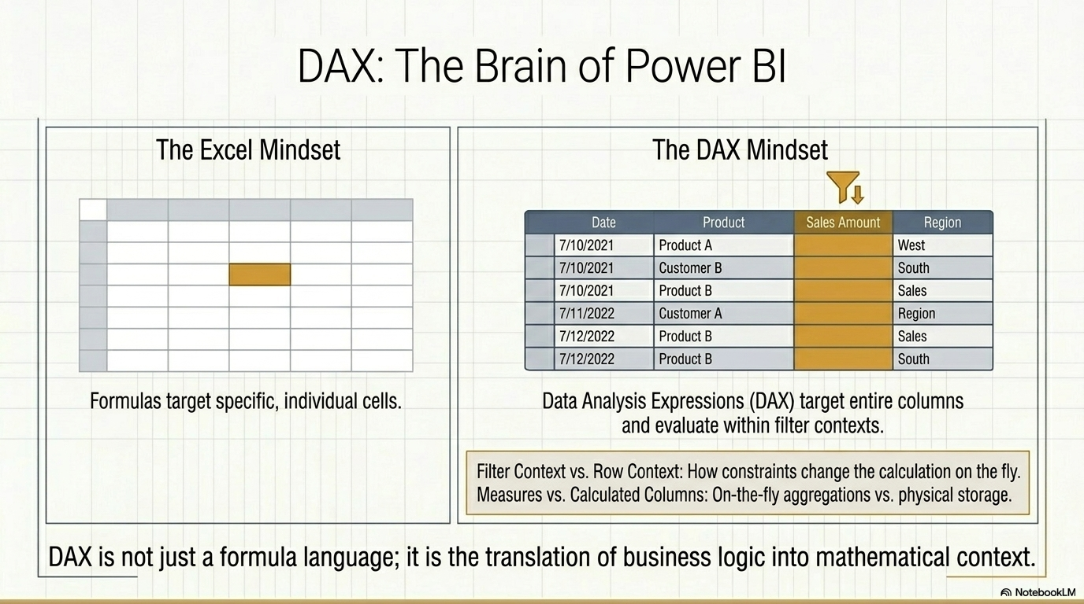

Slide 22
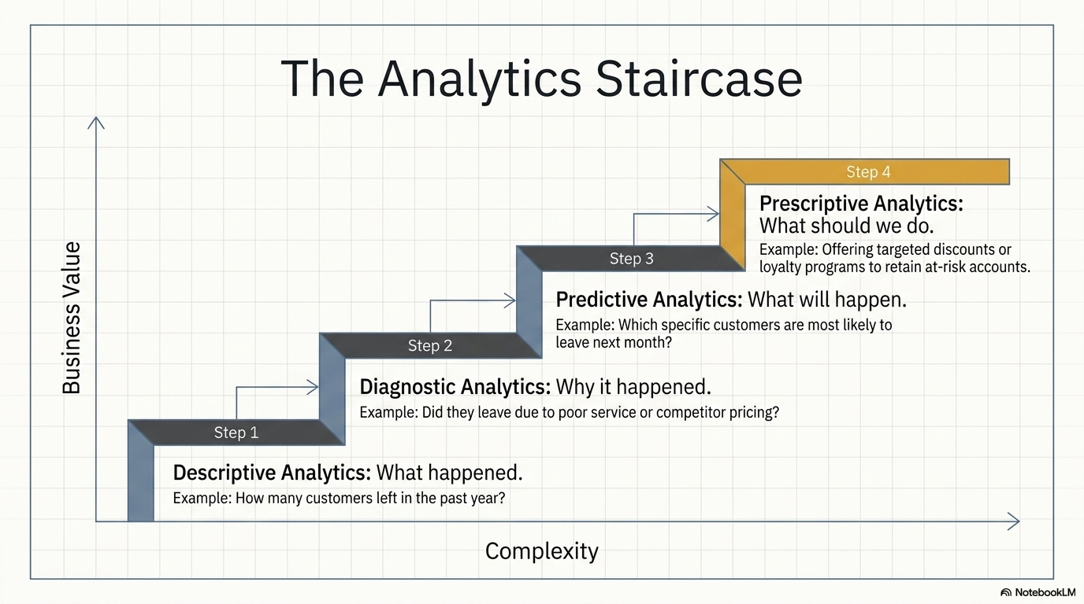

Slide 23
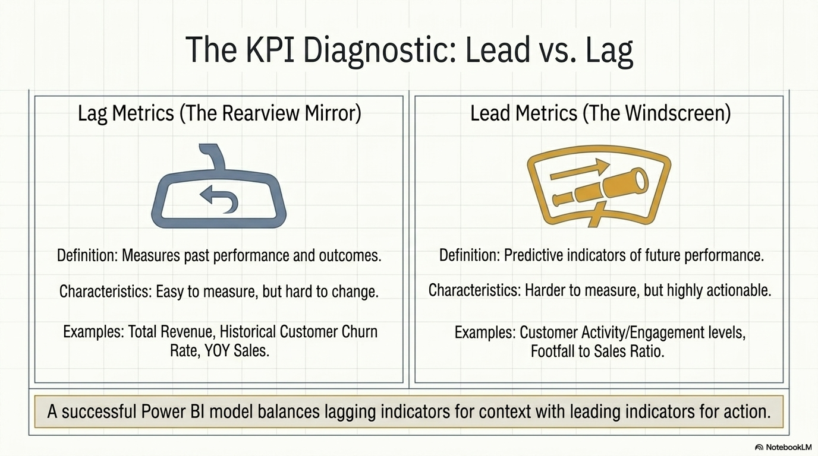

Slide 24
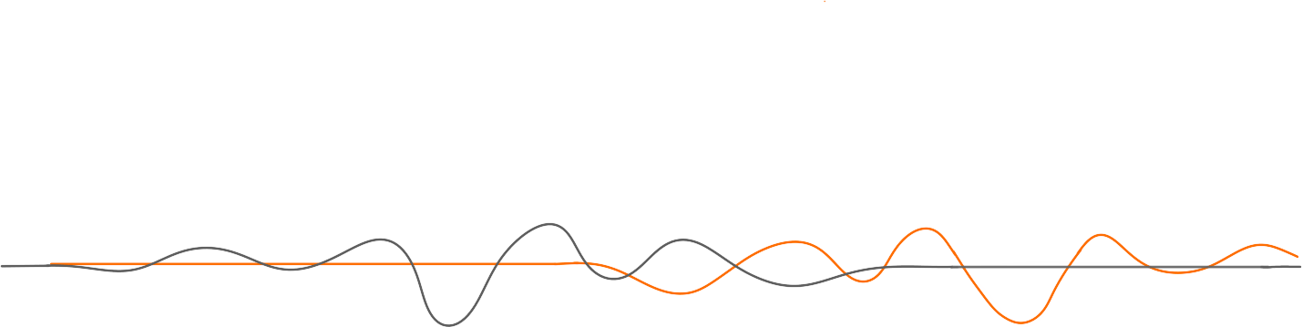
Important Steps in Data Analysis(BI)
Understand BI tool
Understand Business
Model Data
Understand Data
Create Analysis

Slide 25
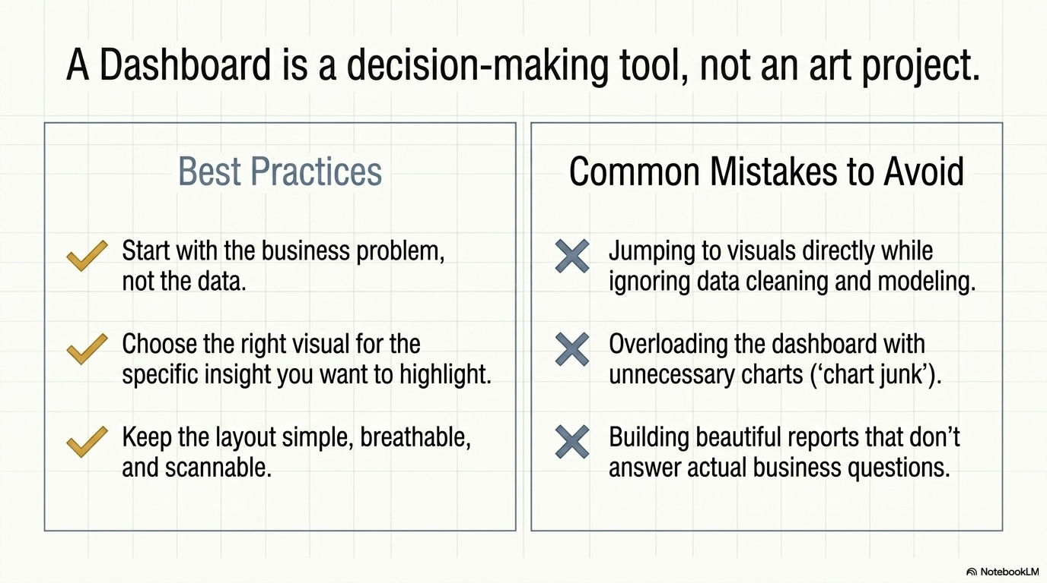

Slide 26
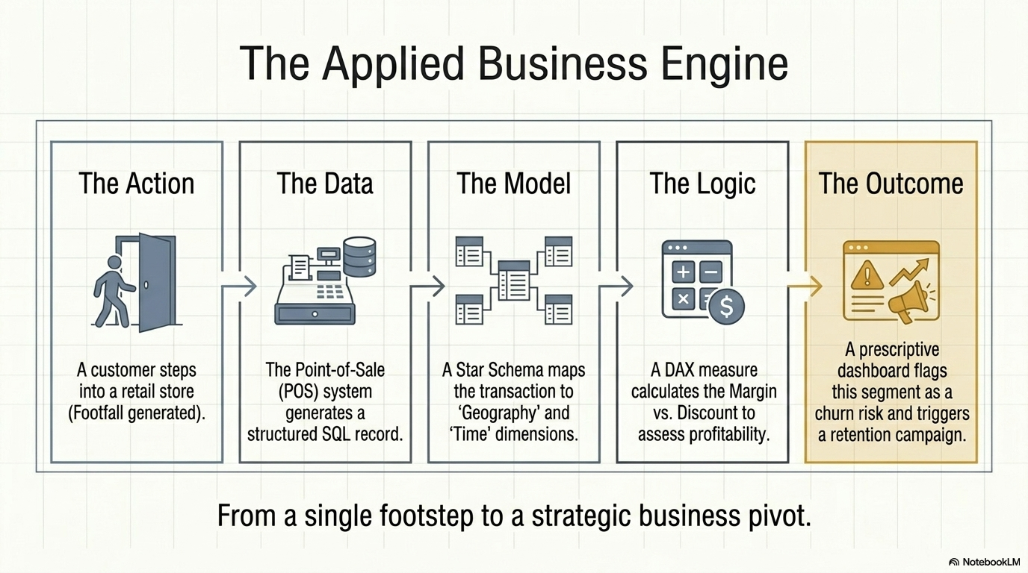

Slide 27
